Slide 1
Flipping Off The World
Grant Pierce

Slide 2

Outline
Project Scope
Introduce Attacks
Live Demonstration
Countermeasures
Lessons Learned
Q & A

Slide 3

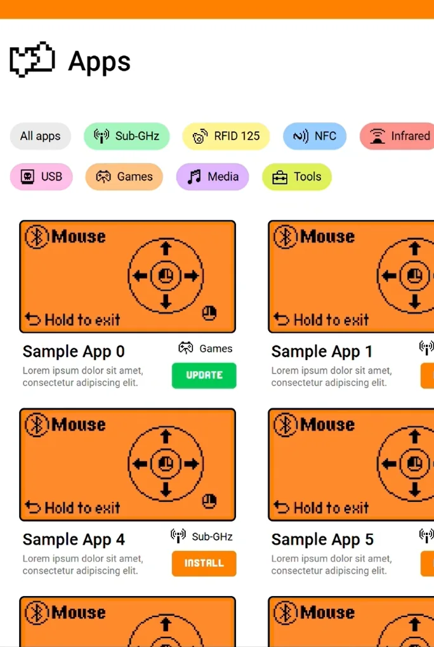
Project Scope
The Flipper Zero is a ethical hacking tool with a multitude of “fun” capabilities already built-in.
RFID Scanning (Hotel Keys)
NFC Reading (Credit Cards)
Emulate Sub-GHz Signals
Infrared Universal Remote
Many resources for the Flipper are open-source, allowing us to customize and truly make it our own.
I decided to explore the potential of this device to launch two distinct WiFi attacks: Evil Portal (Evil Twin) and WiFi Marauder (Sniffing).

Slide 4

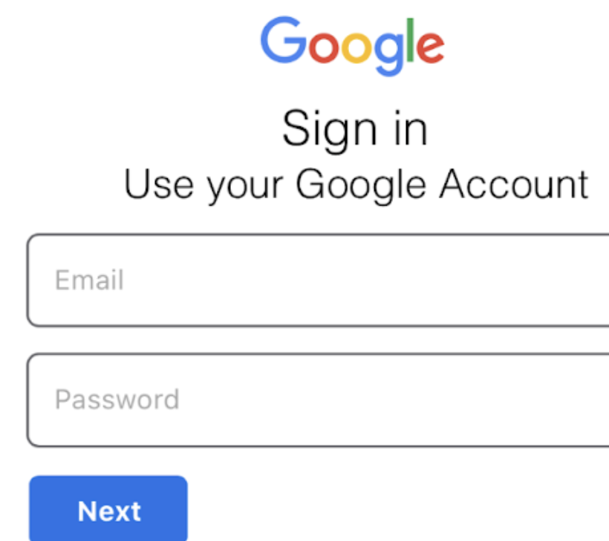
What Is The Evil Portal Attack?
The Evil Portal attack is inspired by the Evil Twin attack, a type of Man-in-the-Middle (MitM) attack.
Evil Twin attacks involve creating a fake Wi-Fi network to steal sensitive information or infiltrate devices.
These attacks are often deployed in public spaces where people are likely to connect to free Wi-Fi networks
Cafes
Airports
Libraries
Hackers can set up these fake networks ANYWHERE!
Easily Deployable

Slide 5
Example Scenario: Starbucks
“Sign On Page”
Credentials Are Harvested
Starbucks WiFi
“Starbucks WiFi”
437X Hotspot
Spawned Fake
Wifi Network
Hacker
Computer
Customer
Computer

Slide 6

What Is The WIFI Marauder Attack?
Combines deauthentication attacks with packet sniffing to force users to disconnect and then capture their WiFi information and user traffic.
Possible Attacks
Disrupt legitimate connections by sending deauthentication packets to the network.
MiTM attack that allows the attacker to intercept vital network and user traffic.
Targets
Public and Open WiFi networks
Cafes, Airports
Insecure WiFi Networks
Older Generation Routers

Slide 7
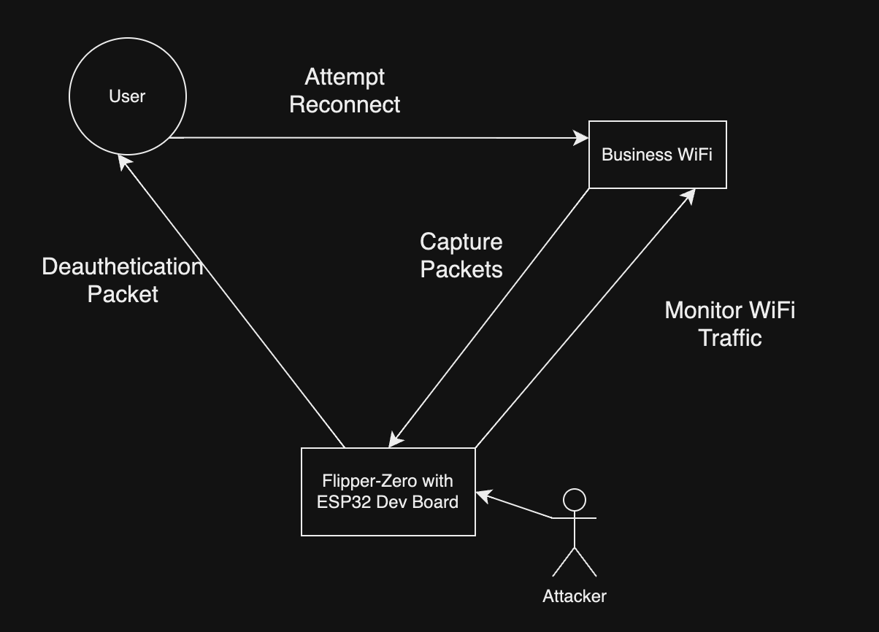
Example Scenario: Business

Slide 8
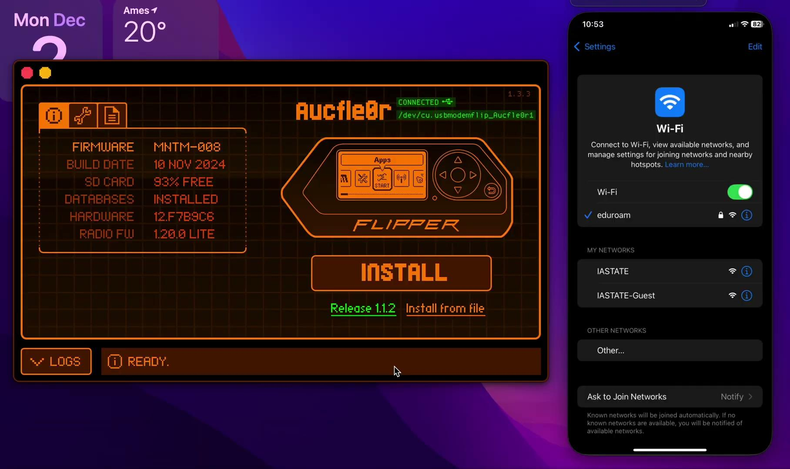
Live Demonstration

Slide 9


Detecting/Defending Against Evil Portal
Detection
Rogue Access point monitoring to detect foreign SSIDs or unusual networks.
WireShark Monitoring
EDR/IDR Detection
Authenticate for unknown IP addresses.
Countermeasures
Wireless Intrusion Detection Systems to detect and blacklist unknown or rogue access points.
Avoid untrusted and public networks.
Use Multi-Factor Authentication for extra- step of security if credentials are stolen.

Slide 10

Detecting/Defending Against Wifi Marauder
Detection
Some tooling (LOCH AirShield, Palo Alto, MSFT Defender) has real-time wireless airspace monitoring and deep packet inspection.
Top 8 Most Common Network Protocols
HTTP
HTTP/3
HTTPS
Web Socket
TCP
UDP
SMTP
FTP
Countermeasures
Wireless Intrusion Detection Systems (WIDS) to monitor and alert of local malicious devices.
Network Segmentation to minimize the impact.
Disable unused protocols, ports, and services.

Slide 11
Lessons From Attacker & Defender Perspective [Both]
Attacker
Wardriving to identify vulnerable networks.
Adapt to the attack to the security environment.
Passive Sniff
Active (Deauth)
Altering HTML File
ETHICAL CONSIDERATIONS!
Defender
Implement stronger wireless encryption protocols (WPA3).
Avoid risks of publicly-facing Wifi networks.
Adopt tooling to identify and mitigate threats.
Rogue Access Point Detection
WIDS & WIPS

Slide 12
Q & A

Slide 13
References
1. bigbrodude6119. (n.d.). *Flipper Zero Evil Portal* [GitHub repository]. GitHub. Retrieved from https://github.com/bigbrodude6119/flipper-zero-evil-portal
2. Electronic Cats. (n.d.). *Flipper Add-On: Marauder* [Website]. Retrieved from https://electroniccats.com/store/flipper-add-on-marauder/
3. Hashcat Team. (n.d.). *cap2hashcat* [Tool documentation]. Retrieved from https://hashcat.net/cap2hashcat/
4. Loch.io. (n.d.). *Defending Against Flipper Zero Attacks* [Blog post]. Retrieved from https://loch.io/updates/defending-against-flipper-zero-attacks
5. Momentum Firmware Developers. (n.d.). *Momentum Firmware* [Website]. Retrieved from https://momentum-fw.dev/
6. NinjaOne. (n.d.). *Types of Network Protocols* [Blog post]. Retrieved from https://www.ninjaone.com/blog/types-of-network-protocols/
7. Praetorian Inc. (n.d.). *Hob0Rules Wordlists* [GitHub repository]. GitHub. Retrieved from https://github.com/praetorian-inc/Hob0Rules/tree/master/wordlists
8. Proofpoint. (n.d.). *Defending Against the EvilProxy Phishing Toolkit* [Blog post]. Retrieved from https://www.proofpoint.com/us/blog/email-and-cloud-threats/defending-against-evilproxy-phishing-toolkit
9. Varonis. (n.d.). *What Is an Evil Twin Attack?* [Blog post]. Retrieved from https://www.varonis.com/blog/evil-twin-attack
10. YouTube. (n.d.). *Flipper Zero Marauder Walkthrough* [Video]. Retrieved from https://www.youtube.com/watch?v=mb2088rmFuU&t=986s

